Slide 1


For all your Fraud Solutions: Amazon Fraud Detector
Trends Marketplace
Aakriti, Addit, Hao, Lakshit, Niharika

Slide 2
Should we care about Fraud?
Fraud not only makes a business lose money, it also opens the possibility of future attacks
Large Corporations ($10B+)
In today’s day and age, digital fraud are the most common
52%
Small Corporations (<$100M)
38%
Experienced fraud in last 24 months
Type of fraud experienced by corp in last 24 months
Experienced fraud in last 24 months
Digital (Cyber) Fraud
41%
18%
22%
Customer Fraud
32%
had $50M+ impact
had $1M+ impact
Others
23%
Source: PwC’s global economic crime and fraud survey 2022

Slide 3



Fraud Detection using Amazon Fraud Detector
Amazon brings power of Machine Learning to power sophisticated one-click Fraud Detection Framework
20 years
Millisecond
of fraud detection expertise
fraud detection response time

Slide 4



Why use Amazon Fraud Detector?
Pre-built Fraud Detection Model Templates
Event Log Tracking Interface
Automatic custom model creation
Amazon’s Fraud Detection Intelligence

Slide 5




Detect all kinds of Fraud!
New Account Fraud
New Account Fraud
Online Payment fraud
Account Takeover fraud
Product Abuse/ Gaming fraud

Slide 6



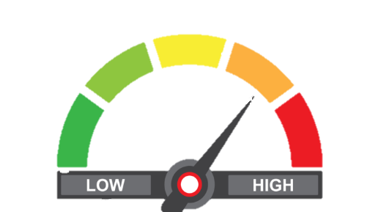
How does Amazon Fraud Detector work?
Amazon Fraud Detector
Fraud Detection
Fraud Detection
Feature Engineering
Inspect and identify input model features
Amazon S3 Bucket
Fraud Prevention Rules (Custom)
Train & Tune Model
Select Algorithms for training and optimization
Amazon Fraud Detector API
Fraud Risk Prediction

Slide 7
Demo!

Slide 8



Amazon Fraud Detector: Success Stories
36% increase in NPS due to safely approving automatic low-risk claims
427% improvement in identifying fraudulent cases
6% drop in fraudulent transactions
90% drop in False positive rates for fraudulent transactions
Drop in Fraud reports by 63%
77% drop in time spent on handling frauds
Returning users increased by 4% due to drop in fake accounts

Slide 9

Thank you!

